Slide 1


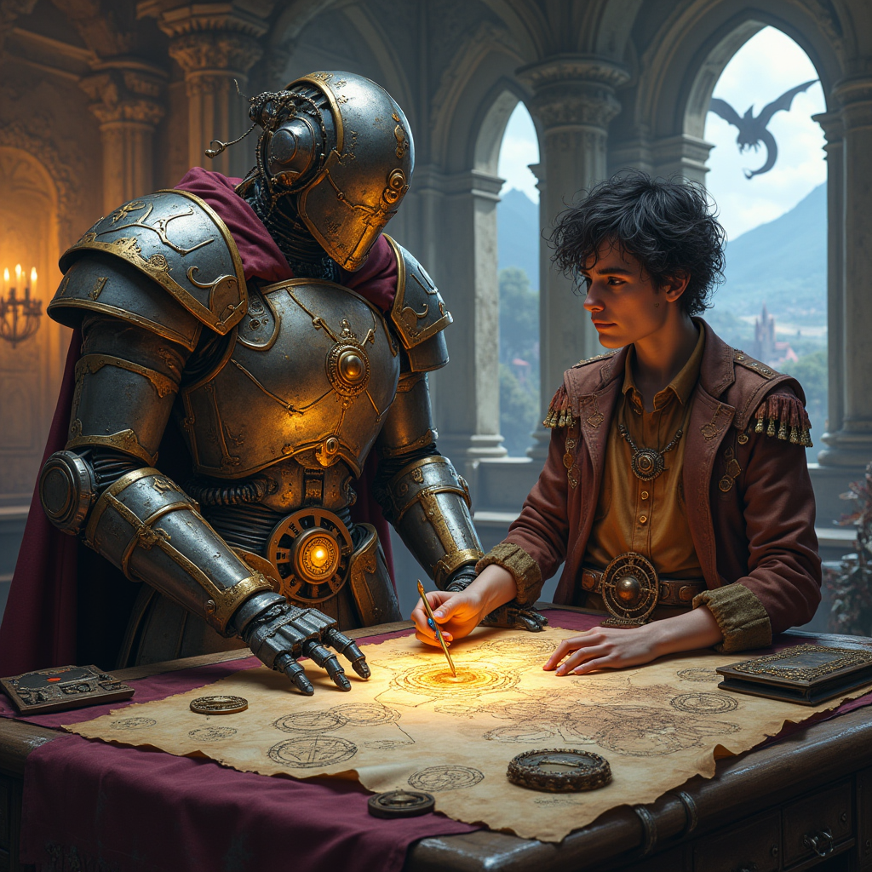
“Hero Squire: AI Guide to D&D Character Creation”
Javi Ansoleaga

Slide 2
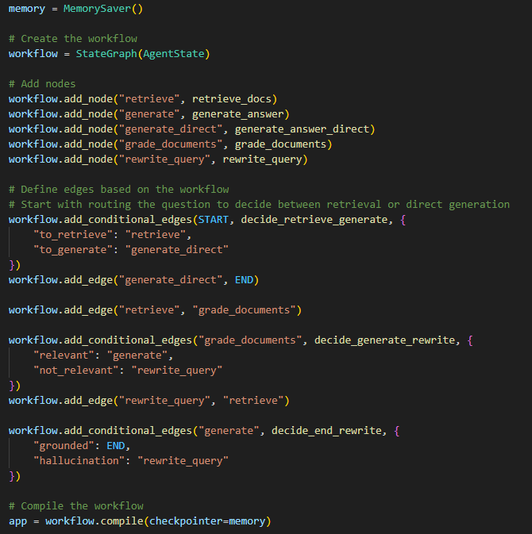
"Embark on your next D&D adventure with a personal AI companion that helps you forge the perfect hero."
Introducing Hero Squire, an AI-powered chatbot designed to assist players in creating D&D characters.
Leverages the official Player's Handbook and curated YouTube guides to provide comprehensive assistance.
Enhances the character creation process with personalized, accurate, and context-aware guidance.

Slide 3
Behind the Shield: The AI Architecture
Key Components:
LangChain & LangGraph:
Implemented an Adaptive RAG model using LangGraph.
Adjusts retrieval strategies based on the user's character creation stage.
Pinecone: Stores and retrieves relevant information from the Player's Handbook and YouTube guides.
ChatGPT-4-turbo-mini: Generates informative responses, guiding users through each step.
Memory Module: Keeps track of user choices to build a cohesive character profile.

Slide 4
Ancient Knowledge: Player's Handbook & Video Guides
Data Sources:
D&D Player's Handbook:
Extracted detailed content on races, classes, abilities, and more.
Addressed complex formatting challenges to ensure accurate information retrieval.
YouTube Videos:
Transcripts from expert-led videos on character creation and roleplaying tips.
Extracted metadata such as topics and timestamps for enhanced search relevance.
Preprocessing Steps:
Utilized Unstructed Loader and PyMuPDF for parsing and extracting data from PDFs.
Organized content into a structured format using pandas.
Created vector embeddings for semantic search capabilities with Pinecone.

Slide 5
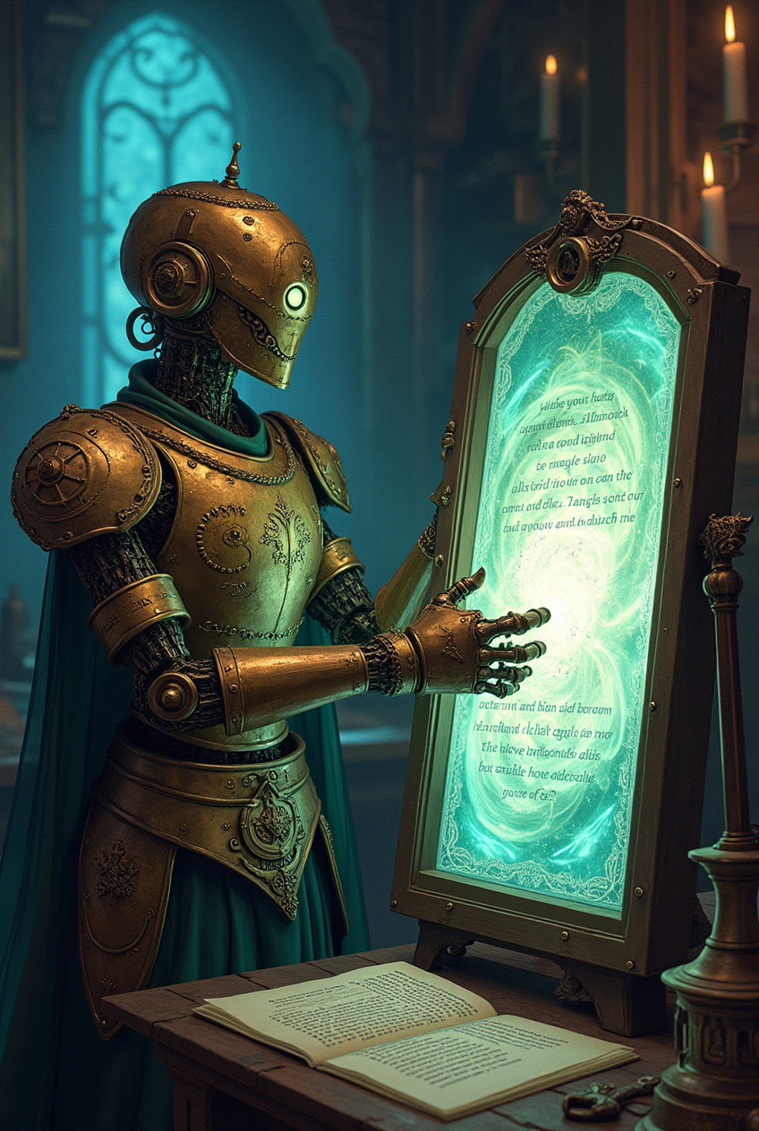
Guiding Hand: The Q&A Agent
Adaptive RAG with LangGraph:
Dynamically adjusts information retrieval based on user input and progression.
Enhances response relevance for specific character creation aspects.
Prompt Engineering:
Developed detailed and specific prompts for each of the graph’s node.
Functionality:
Assists users in selecting race, class, background, and abilities.
Provides explanations of game mechanics and roleplaying suggestions.
Remembers user decisions to construct a comprehensive character profile.

Slide 6
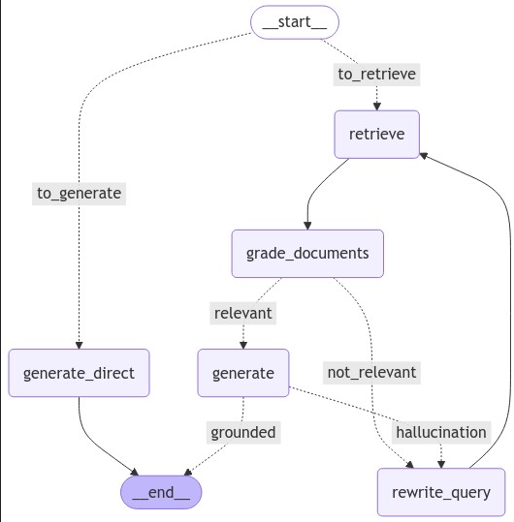
Forging Ahead: Implementing Adaptive RAG with LangGraph
Adaptive RAG enhances the chatbot's ability to provide tailored assistance.
Even though the structure is overkill, it lays the groundwork for future expansions and feature additions.
Quite the adventure venturing into the unknown by integrating LangGraph.

Slide 7
Unique Trinkets
LangChain & LangGraph: Frameworks for building a dynamic and responsive conversational agent.
Pinecone: Fast and scalable vector database for efficient semantic retrieval.
ChatGPT-4-turbo-mini: Generates context-aware responses that guide users effectively.
LangSmith Integration:
Integrated with LangSmith for monitoring and potential evaluation.
Includes graph nodes for grading responses and detecting inaccuracies or hallucinations.

Slide 8
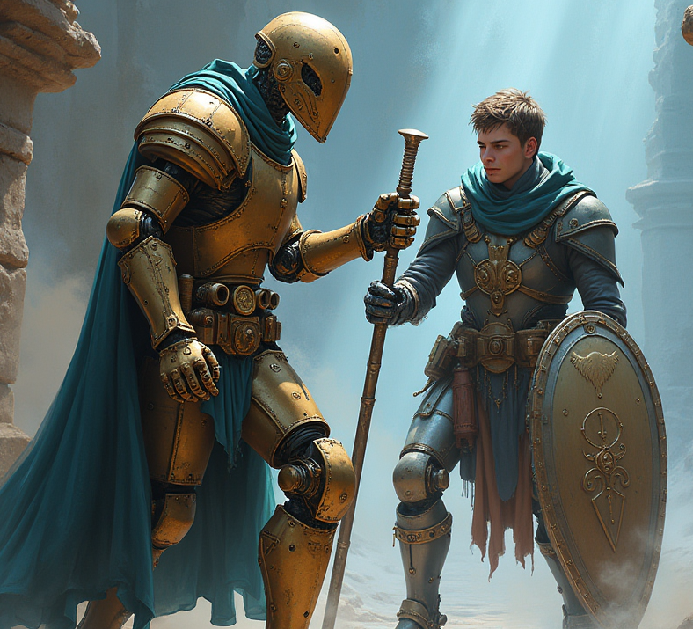
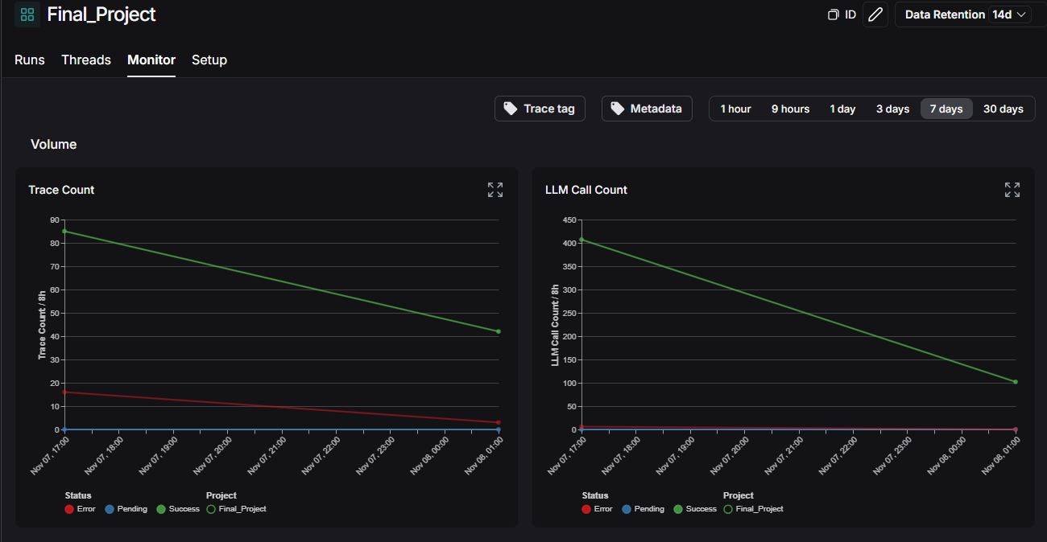
Sharpening the Blade: Evaluation with LangSmith
While extensive evaluation was not completed, integration with LangSmith enables:
Monitoring chatbot performance and user interactions.
Grading document retrievals and responses for quality assurance.
Detecting and analyzing any hallucinations or inaccuracies.
This setup positions Hero Squire for ongoing improvements and reliability.

Slide 9
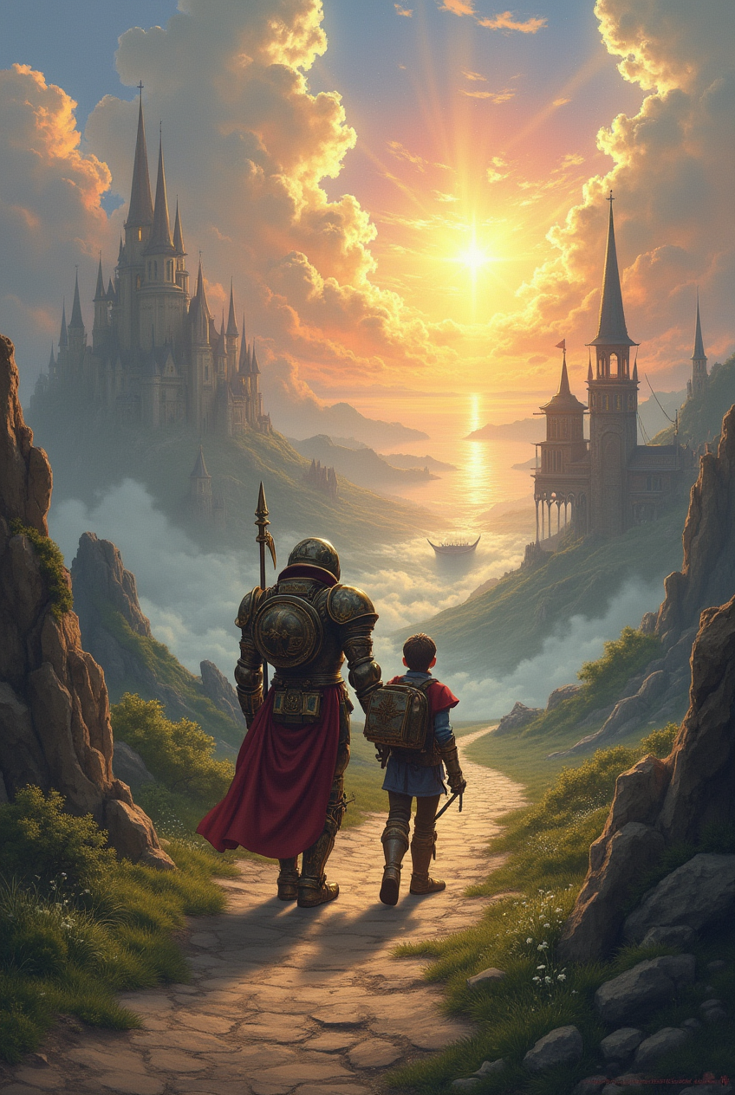
Onward to Adventure
Achievements:
Developed Hero Squire, an AI assistant that enriches the D&D character creation experience.
Implemented advanced AI frameworks, setting the stage for future innovations.
Future Enhancements:
Metadata Utilization: Leverage detailed metadata to refine retrieval based on specific user queries.
User-Provided Content: Allow users to input their own YouTube URLs for personalized guidance.
Interactive Interface: Display a side panel summarizing the character as it's being built.
Customization Options: Introduce sliders for users to adjust response length and complexity.
Audio Features: Implement voice input and text-to-speech for a more immersive interaction.
Code Refinement: Clean and refactor codebase, transitioning notebooks into modular Python files.

Slide 10
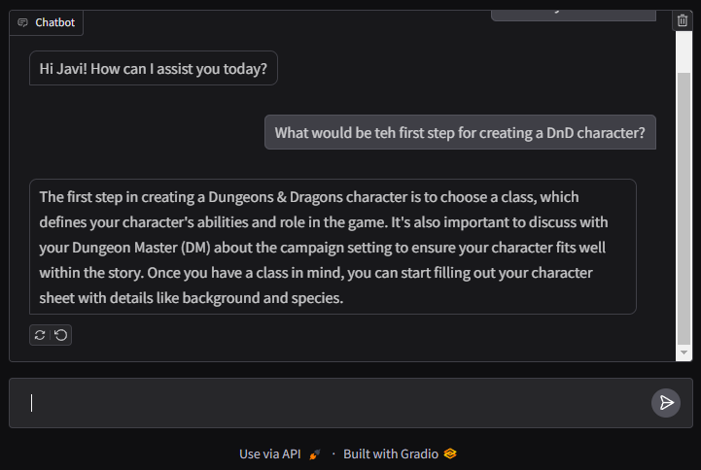
Demo: Crafting a Character with Hero Squire
Notes:
Have a script ready: Start by choosing a race (e.g., Dwarf) and class (e.g., Paladin).
Discuss ability scores, skills, and background options.
Provide insights from the Player's Handbook and YouTube experts.
Show how the AI remembers choices and updates the character summary.

Slide 11
Thank You for Joining the Adventure
Any Questions?
Repo: https://github.com/Grimngor/Final-Project-Multimodal-chatbot-for-YT-video-QA
Linkedin: https://www.linkedin.com/in/javiansoleaga/
Notes:
Have a script ready: Start by choosing a race (e.g., Dwarf) and class (e.g., Paladin).
Discuss ability scores, skills, and background options.
Provide insights from the Player's Handbook and YouTube experts.
Show how the AI remembers choices and updates the character summary.

